Slide 1
Chhattisgarh Digital Secretariat Project by A.M.Parial, Vice Chairman, CHiPS 29th September 2014

Slide 2
Objectives
Create an Office Management System
Ensure efficient & transparent administration
Enhance Productivity
Enable Prioritization of work
Use IT as an enabler to help in daily work
Design an efficient workplace
Enable Policy Based Processing
Provide a mechanism for information and experience sharing

Slide 3
Activities of Secretariat
Document Preparation, Management & Information dissemination
File Management - Creation, Movement, Noting / commenting, Storing, Search etc
Correspondence (DAK) Management – DAK Receiving, marking, forwarding, filing, searching etc
Response Preparation & delivery
Approval & other Administrative Processes
Policy formulation
Others
Need for new ways meet the high citizen expectations and to battle inefficient operations arising from multiple segregated procedures

Slide 4
Workflow in government -

Slide 5
Department & Official Feedback
मेरी टीप
मेरा अभिमत
Objection

Slide 6
Departmental Approval Cycle

Slide 7
Multiple processing of files
Department Meeting Minutes
Same file is processed in parallel in more than two section, divisions or departments e.g. Draft tender condition are processed on a file by say Finance and Law Dept.

Slide 8
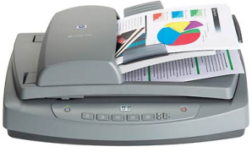
HCM
Concerned Dept .Minister
Approve / Return the file
CS
for coordination
ACS / PS / Secy./SS
Other Department
Approve / Forward / Returns
the file
DS / JS / AS
Registry clerk scans the incoming document(s) and then inwards them
Under Secretary
Forward or Returns the file
Section Officer
An File comes from Citizen/Govt. Offices
Send to the respective section
Assigns
Correspondence
Creates File and forwards
Section Clerk
Receipt & Dispatch Clerk

Slide 9
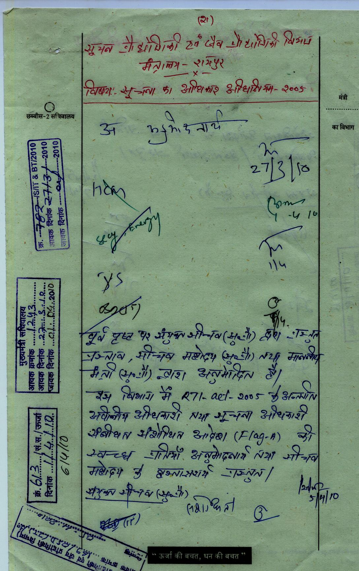
Components
Document
=
Owner department
Title
Description
Creation Date
Version Number
Modified Date
…….
Attribute
+
Content: Text
Graphics
Index Terms
Content

Slide 10
Today’s Secretariat: Key process areas and issues
DAK Movement
Multiple register entry - increase manual efforts, prone to mistakes
File Movement
Policy based processing– prone to human errors
Searching files in critical situations
Archival
Maintaining large volume of files/ documents
Difficulty in preserving manual files – chances of damage and loss
Retrieval and Tracking
Various number generated for same DAK
Time taking process (multiple copies of same DAK )
Lengthening of File Movement cycle due to absence of a single official
Increasing cost and space to preserve files
Tracking of files in movement
Inter-departmental consultations
Prioritization of files
Lack of a “birds eye view” on the efficiency of a department

Slide 11
Solution Requirements
Create an End to end Secretariat Management System for all its activities
Ensure efficient & transparent administration
Enhance Productivity
Enable Prioritization of work
Use IT as an enabler to help in daily work
Design an efficient workplace
Enable Policy Based Processing
Provide a mechanism for information and experience sharing

Slide 12
Solution Framework
Automating routine tasks – file processing/note sheets (workflow), numbering, maintaining personal register
Help in decision making - checklists, access to precedents in old files, acts, rules, statutes
Prioritizing work - reminders, automated prioritization of pending work
Building a knowledge base – circulars, acts, notifications, precedents, documents, circulars
Providing interdepartmental interface
Creation, Movement, Tracking and Storage of Files in the department
Quick retrieval and preservation of old records

Slide 13
Digitization Lifecycle
Scanning
The relevant Files of the departments are scanned
Scanning is carried inside Departments to maintain security and confidentiality
Quality Check
Removal of dark patches, lines, etc.
Alignment of pages, Correction of Page Number mismatch
OCR (English typed fonts) to make the files fully searchable
Meta Data Entry
The meta data are captured for each and every files to uniquely identify them by simple search mechanism
Fields like File Name, Subject, Year, Department, Section, Type of File (R/F/Shadow/Confidential), etc.
Meta Data Validation
The meta data are validated by another team with the scanned files
This team checks whether the correct files are mapped with the right meta data or not
Upload Documents
The documents are uploaded to the system in logical manner (Department-wise) with proper authentication
The uploaded documents are mapped with the metadata so as to make the files (Notesheet and Correspondences) easily searchable

Slide 14
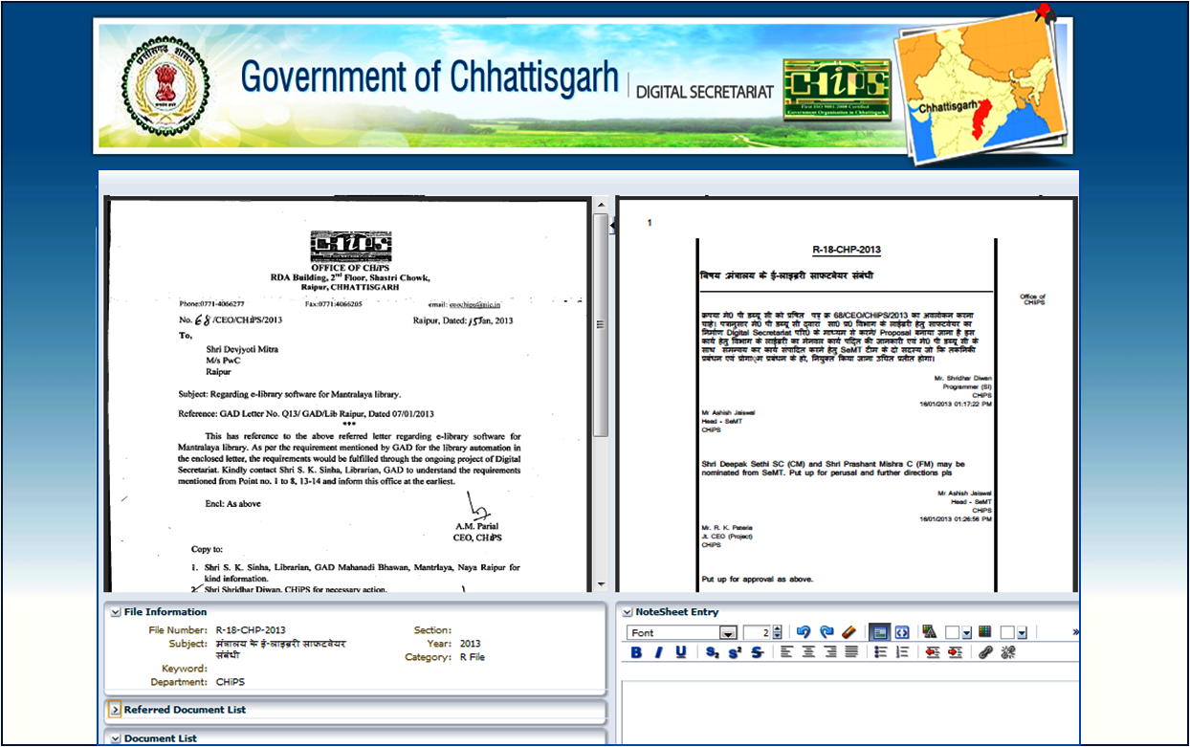
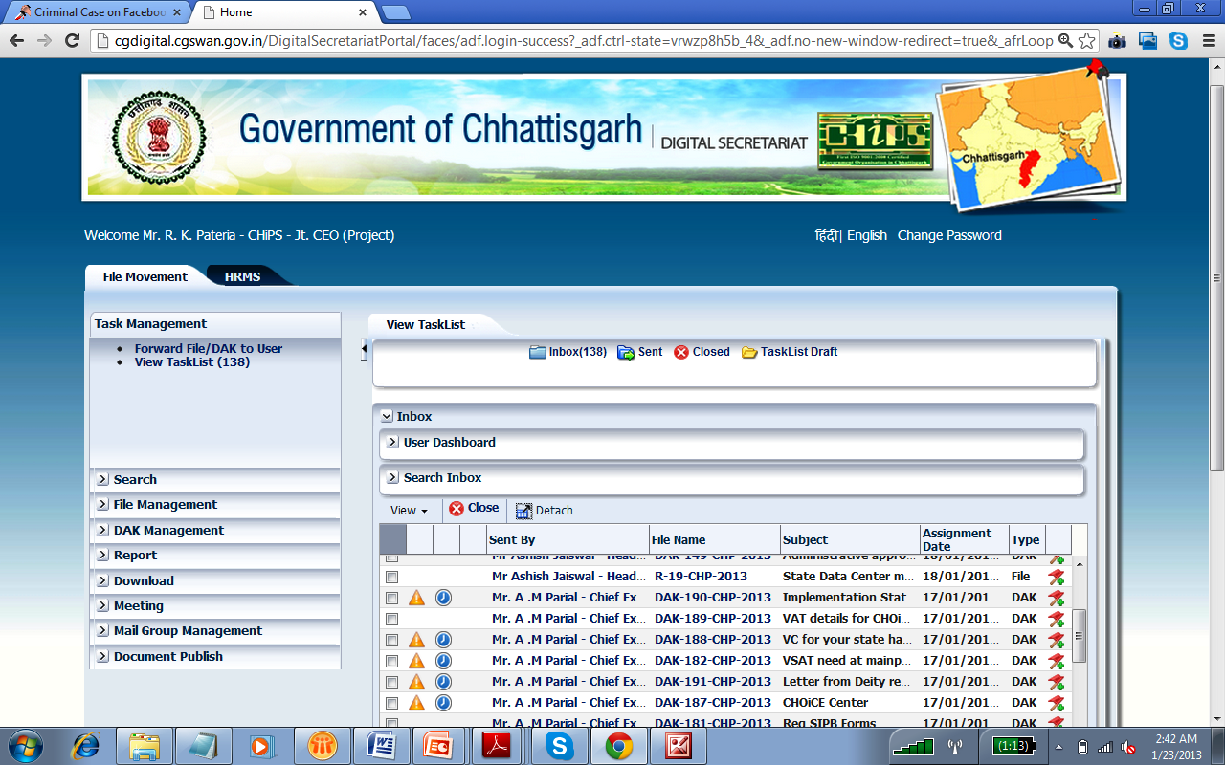
Simple View, Easy to Adopt

Slide 15
The transformation……
 | Then | Now
Search File | Ask the responsible staff to provide the file The staff searches for the file The staff processes the file and send to the table | Search it on the system, know about the whereabouts - No dependency Online Searching and Forwarding Files uploaded - system filter by parameters like year, subject, etc.
Preparing File | Go through the File contents and correspondences Put Note-sheet comments Attach the necessary documents Forward the file | Refer to other relevant documents in File / correspondences Can attach document (pdf/docx/ppt/excel) from any existing DAK or files Can Flags (even with specified Page number) before forwarding the file No paper wasted - entirely automated (Multilingual facility provided for writing Notesheet)

Slide 16
The transformation……
 | Then | Now
Forward File / DAK | Files and DAKs are forwarded manually Requires considerable amount of time for transaction Inter departmental file transfer at different location, this transaction time is even longer Takes time, effort & resources | Mail like feature where a file or DAK can be send by selecting the recipient’s name or designation On clicking ‘Send’ button, the file or DAK is forwarded to the next user Thus it saves time, paper, man effort and money
Creating a File | All manual with fresh note-sheets and necessary correspondences Manual File number allocation as per the File Register Need to put the subject of the file Puting notesheet comment manually and forward the file | The File creation facility through system including R-File, Part File, Shadow File Generated automatically based on the rules set by General Administration Department No page wasted

Slide 17
The transformation……
 | Then | Now
Meeting | The meeting request are sent to the participants via official letters Hard to maintain the meeting dates Possibility of clashes of meetings at the same time | System create meeting request & send to all the participants Auto request to multiple participants electronically Monitor the status Accepted/ Rejected/ Pending Alerts Set auto schedules for user
Easy Access- Secured Access | The files or DAKs can be accessed only in the official hour In case of urgency the respective officers need to come to office While travelling cannot access the files. Entire process gets delayed. Need to clear piled up files after return. | Web based – any where / any time With Internet access and any device like laptop or iPad can access the files that are sent - Just like emails Securely carrying the entire office on laptop Security features to authorized accesses Features like OTP, digital signature, Captcha, etc. helps the system to maintain necessary security

Slide 18
Responding to Urgent Situations
During VidhanSabha Sessions
Numerous files are required to be available in short time
Response to Judiciary
Inter departmental file consultation becomes very easy within a short time span
Quick search of multiple files can easily be done
The search related facilities mentioned above holds true for Judiciary processes as well

Slide 19
Other Important Features
Part Files/ Shadow Files
Can create Part Files/ Shadow Files in case of parallel movement
Meeting
Automatically merge the Part File with Parent File
Meeting Scheduler/ Send Meeting Request
Accept/ Decline with remarks
View the pending Meetings
HRMS
Integrated with the HRMS System of Mantralaya
Provision of linking a Shadow File with Parent File
Important Features: Personal Profile/ Leave Management Transfer/ Promotion

Slide 20
Progress till date
Pages
Total number of pages that were scanned is more than 1.2 crores
1.2 crores
Files
Departments
Approximately 2.3 lakhs files are scanned during the project
2.3 lakhs
42 departments
Digitization work completed in 42 departments of Mantralaya
DS
STATUS
Implementation
Training
The Digital Secretariat System is running in Energy, GAD II, IT&BT, Planning, 20 Points, Tourism, Culture, Transport, WCD, Sports, Higher Edu., Social Welfare, PR. Also running in NRDA and WCD Directorate
Training of the system provided to Energy, Finance, GAD II, IT & BT, Planning, 20 Points, Tourism, Culture, RTE, Transport, Higher Education, Labour, PR, WCD, Social Welfare, Sports, Technical Edu
13 departments
17 departments
38,000
Transaction
Almost 38,000 files and DAKs have been transacted through the system

Slide 21
Benefits
Effective Security (Digital Signature)
Effective Decision Making
Automate Tasks
Reduced Paper Work
Prioritization of Work
Easy Tracking
24*7 Access
Reminder Notification
Audit Trail
Digital Secretariat

Slide 22
Thank You

