Slide 1
Green State IT
RISK ADVISORY SERVICES
An initiative towards higher maturity for managing software
Strictly Private and Confidential
Draft
29 September 2014

Slide 2
E-governance: Road to automation
–
Software used to develop e-Governance applications help to transform a nation into an information society
Software has helped automate routine Government functions for efficient delivery of services
Enables government departments to improve processes to serve its citizens efficiently and transparently
Software in e-Governance as a driving force towards economic growth & development
Use of software along with appropriate technology enhances enforcement of Law & Order.
Facilitates direct access to citizens for government functions and decision-making processes
Green State IT • An initiative towards higher maturity for managing software
2

Slide 3
Challenges in managing software
–
Feasibility analysis to align software with organisation’s Requirements
Managing asset inventory and licensing position
Are all software assets managed through mature processes?
Protecting IT systems and DR/DC sites from security threats of viruses, spyware and malware
Understanding of License Agreements and associated terminologies
De-centralised purchasing and maintenance of records leading to over-spending
Absence of automated tools for monitoring software
In-depth knowledge of software features & functionalities
Green State IT • An initiative towards higher maturity for managing software
3

Slide 4
Should you worry about your software assets? - A Case Study
–
Situation – A large conglomerate with interests in Heavy Engineering and Manufacturing was nominated by a leading software publisher for a software license review.
Observations made | Identification of unlicensed software across the network Security concerns due to keygens, cracks, spyware, malware and counterfeit software Underutilisation of purchased software
Possible reasons | A root-cause analysis yielded the following reasons for the above findings: Low awareness levels Low SAM maturity De-centralized Purchases / no centralized records
Impact | Unplanned expense due to spend on gap-fulfillment Compromised governance and IT Security Loss due to time-cost spent on sudden review exercise
Green State IT • An initiative towards higher maturity for managing software
4

Slide 5
Our experience: Reality check!
–
PwC’s experience and assessment indicates a trend as follows:
Organisations are not planning their strategic investment in software with respect to Procurement, Deployment and Retirement.
Organisational complexities are resulting in a mismatch of expectations between software users and procurers, leading to situations of compromised governance within IT functions.
Most government departments follow an ad-hoc approach for tracking and managing inventory of software.
Organisations are exposed to security threats caused due to presence of cracks, keygens and malware
The result: multiple cost centres, duplicate purchases, lack of controls, threat of security risk, non-optimal deployments of software and several man-hours being wasted in such exercises periodically.
Green State IT • An initiative towards higher maturity for managing software
5

Slide 6
How should software assets be managed?
–
Selection
Evaluation of product alternatives
Provisioning
Introduction of new products
Disposal
Cleanup of all systems
Business Requirements
Software Lifecycle Management
Alignment
Alignment of
supply and demand
Allocation
Based on specific business requirements
Enabling an optimal balance of user needs and software costs.
Profiles are matched to specific software editions.
Alignment
Cleanup of unused and unauthorised installations
Align install base with actual demand.
Streamline deployment of software.
Allocation
Approval of application
entitlements
Monitoring
Analysis of deployment and usage
Monitoring
Centralised database of deployed software.
Quick identification of unused installations to check over-deployments.
Green State IT • An initiative towards higher maturity for managing software
6

Slide 7
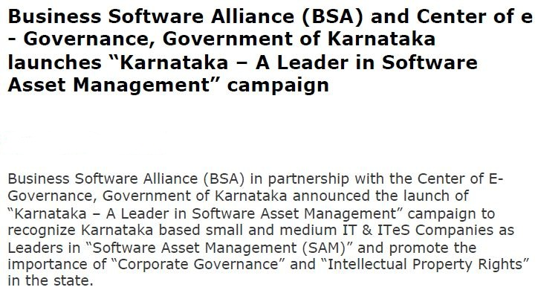
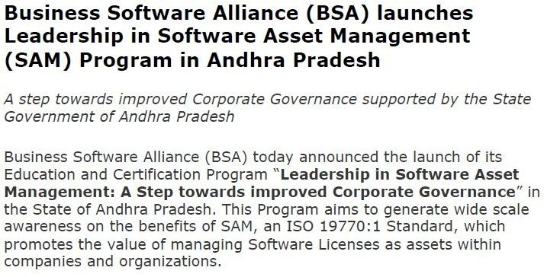
Few Green IT initiatives undertaken by various states
–
KARNATAKA
MAHARASHTRA
ANDHRA PRADESH
Source: http://www.bsa.org/
Green State IT • An initiative towards higher maturity for managing software
7

Slide 8
Key pillars
–
Training & awareness
Define roles & responsibilities
Planning & Execution
Inventory tool enhancement
Data analytics and notifications
Test of effectiveness
Process recommendations
Policy implementation
Maturity enhancement
Green State IT • An initiative towards higher maturity for managing software
8

Slide 9
Green State IT - Benefits
–
The benefits for Green State IT are:
Encourage innovation through promotion of IPR protection and reducing software piracy
Green State IT – a SAM perspective
Promote strong corporate governance standards
Build sustainable competitive advantage by enhancing IT competitiveness & governance
Make the industry more globally competitive, secure and efficient
Better Management of Software Assets
Software Asset Reconciliation across vast network of offices
Promote industrial investment and economic development in the state
Efficient deployment of software leads to reduction in software costs
Higher legitimate revenues for the industry, more taxes to government, and more hi-tech high wage jobs
Build awareness and knowledge on Licensing metrics and contractual terms
Green State IT • An initiative towards higher maturity for managing software
9

Slide 10
Green State IT (a SAM perspective) - Program for Chhattisgarh
–
PwC would propose to the state of Chhattisgarh, a program for establishing a Green State IT model by promoting respect for Intellectual Property Rights (IPR) protection and improve management of software through implementation of ISO recognized SAM (Software Asset Management) standard practices within Government departments and businesses.
This program will encourage innovation and help promote strong corporate governance standards making the state-based industry globally competitive, secure and efficient, translating into higher legitimate revenues for the industry, more taxes to government, and increase in hi-tech jobs.
Green State IT • An initiative towards higher maturity for managing software
10

Slide 11
Green State IT – Next steps
–
Recommended Next Steps for State Governments:
State Government / State Departments should internally deliberate to adopt the Concept of Green State IT
Conduct comprehensive Software Asset Management within your departments
Optimise your Software deployment and leverage from Best Practices implemented by States on Governance on IT and Software Enablers
Sensitization programs towards “Respecting IP” / security
Regular training on an on-going basis
Green State IT • An initiative towards higher maturity for managing software
11

Slide 12
Thank you
Amol Pitale
Senior Manager
Licensing Management & Contract Compliance
PricewaterhouseCoopers Private Limited
Email: amol.pitale@in.pwc.com
© 2014 PwC India. All rights reserved. In this document, “PwC” refers to PwC International Limited, which is a member firm of PricewaterhouseCoopers International Limited, each member firm of which is a separate legal entity.

