Slide 1
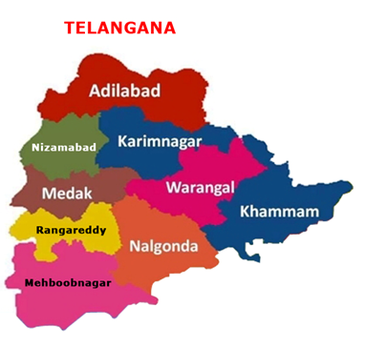
Ration cards – Reaching the needy
Smart PDS – Integrated approach
Govt of Telangana

Slide 2
Over view
Telangana State
No of Districts --- 10
No.of Mandals .. 467
MLS point .. 173
No. of fair price shops .. 17163
Hyderabad
No of Circles - 9
No of Shops - 857

Slide 3
END TO END COMPUTERISATION
Aadhar backbone
Component I
ePDS – entire Telangana
Supply Chain Management – Vehicle Tracking system -1 circle in Hyderabad.
Component II
FP shop automation – 45 shops in Hyderabad.

Slide 4
USAGE OF AADHAR
Seeding in ration card database - savings
Aadhar – common field to pull data from other databases
LPG data base – Savings in Kerosene allocation
Eligibility of House holds from Samagra Survey data for new Food security cards
ePOS – online Aadhar authentication of card holder – savings
No pink cards – only aadhar as ID proof

Slide 5
SEEDING – Beginnings - Hyderabad
Collected Xerox copies of EID/UID from ration card holders.
Format given
EID/UID for each member in the family.
does not give – reason mentioned - married /migrated / dead.
Methods of collection
In each circle (9 circles) – top 10 inorganic seeded shops
Inspectors attached to the shops to collect EID/UID.
Later FP shop dealers collected the EID/UID.
Other Dists also through FP shops
Purpose of collection
To confirm inorganic seeding – KYR+ data
For Organic seeding -To enter EID /UID manually into Ration Card Database

Slide 6
PUBLIC – Resistance to Acceptance
Strong resentment from public - 2012
Refusal to give
Court litigation.
Acceptance with reluctance-
Public awareness by personally visiting the FP shops
Appealing to the public representatives in various forums – benefits of Aadhar
Mid 2013 – new applications given with EID/UID . Voluntary acceptance.
- How ----- Benefits of seeding

Slide 7
SEEDING – BENEFIT TO CARD HOLDER
Activation at the local office
Some of the cards activated belonged to very poor persons, whose cards were deleted in 2009 field survey and were running from office to office since then
Whenever a card holder comes with his EID/UID the inspector verifies and the ASO activates the card after software checks for duplicates
So the system is citizen friendly to the genuine card holders.
Since one year 37,438 BPL cards have been activated.

Slide 8
SEEDING – BENEFIT TO DEPT
Validations in seeding –
duplicates not allowed.
Algorithms introduced
Prune existing cards
Seed EID/UID if persons are available
If EID is rejected, facilitate for re enrollment
If EID is pending, request UIDIA for priority processing.
Deactivate if the person is not found. Bogus removed

Slide 9
STATUS OF AADHAR SEEDING - Hyderabad
BPL cards – 6,23,807
Units – 20,94,155
Seeded units – 20,93,718
% of seeding – 99.98

Slide 10
Savings - HYDERABAD
S. No. | Year | White cards | Units
1 | 30.1.2011 (Prior to giving Rachabanda (RB) cards) | 6,50,321 | 26,26,328
2 | Total cards printed in between 2011 & RB III (Feb., 2014) | 2,06,616 | 10,48,937
3 | The cards that would have been in circulation if ePDS & Aadhaar was not introduced. ( Sr. No. 1+ 2) | 8,56,937 | 36,75,265
4 | Position in ePDS as on TODAY | 623807 | 2094155
5 | Savings achieved as a result of collecting Aadhaar in ePDS ( Sr. No. 3 - 4) | 233130 | 1581110
6 | Savings % (Sr. No. 5 / 3 X 100) | 27% | 43%

Slide 11
STATUS OF AADHAR SEEDING – Telangana
BPL cards – 79,86,252
Units – 2,47,93,856
Seeded units – 2,33,91,282
% of seeding – 94.34

Slide 12
Savings – Telangana State
STATUS IN JUNE,14 Versus NOVEMBER,14
Particulars | In June 2014 | In November 2014 | Difference
No.Of BPL Cards | 91,84,991 | 79,65,0,28 | 12,19,963
No.Of BPL Units | 3,21,43,953 | 2,47,47,002 | 73,96,951
Rice Allotment (Mts) | 1,39,037 | 1,15,814 | 23,223
23,223 MTs saved.
Ie Rs 15.28 crs savings per month.
Rs 183 crs per annum

Slide 13
AADHAR AS COMMON FIELD
LPG database
Kerosene allocation – 1 litre to LPG holder & 4 ltr to non LPG holder
Oil Company data – LPG dealers seeding
57 lakh records got - 47 lakh seeded - 20 lakh mapped with ePDS
July 2014 allotment -1.66 crs litres before
August – 1.33 crs litres allotment
Savings – 33 lakhs
Allocation to rachabanda cards
1 litre extra to Rural - earlier 2 litres now 3 litres

Slide 14
AADHAR AS COMMON FIELD ---
Samagra Kutumba Survey (SKS)-
Compare Aadhar in application form for new Food Security card (NFSA guidelines) with that in SKS
Determine eligibility - No income criteria
Exclusion
All govt employees
Four wheel owners
All pan card holders/credit card holders/debit card holders
People having landed property - 2.5 acres wet or 5 dry
People having pacca house

Slide 15
AADHAR AS COMMON FIELD ---
Samagra Kutumba Survey (SKS)-
Inclusion
Homeless / houseless persons or persons
residing in temporary establishments, buildings, huts, etc.
vulnerable occupation like beggar / rag picker,
no male able–bodied person
Vulnerable Tribal Groups’ Communities
Destitute households
Landless households deriving a major part of their income from manual casual labour.

Slide 16
COMPONENT I - ePDS - modules
online software application - by State NIC.
Aadhar seeding – data entry of UID/EID nos
Ration card management (RCM)
DKR generation– Register conatining the names of ration card holders
Mutations - link with Meeseva
Allocation – Linked to eSEVA for payments by FP shop dealers.

Slide 17
ePDS – RCM - DKR generation
Tahsildhars maintain and manage cards by making inactive/active and transfer and tagging of cards to shops etc
Total Card strength is taken and the Dynamic key registers are generated for the month for the entire state by the deputy director
After Commissioner approval , Key registers are released to be printed as sale registers for all fair price shops

Slide 18
ePDS – RCM - Mutations
MeeSeva kiosks take applications from card holders seeking changes in cards and shops.
Tahsildar forwards to inspector for enquiry
Inspector enters remarks & returns to Tahsildar
Tahsildar approves and Digitally signs.
Ration cards get printed at the MeeSeva kiosk
Changes updated automatically in ePDS database.

Slide 19
ePDS – Allocation
ASOs / Tahsildars enter fair price shop wise closing balances within a specific time period
Allocation is then generated based on DKR.
Allocation upto F P Shop level. No descrition
System generated allocation proceedings.
Through web service eseva kiosks get the allocation details
They start accepting fair price shop payments based on this allocation
Payment data is immediately updated in ePDS through web service.

Slide 20
SUPLY CHAIN MANAGEMENT
links FCI to MLS point to the FP shops.
Linked to eSeva to get the details of Ros - After payments are sent to ePDS, Release orders so generated are automatically seen in MLS point logins for booking stock/commodities in Trucks to be sent to fair price shops.
system generated truck sheets. SMS on stock arrivals
Now running in 1 MLS point through VPN connection.
Vehicle tracking system also in same circle
Scaling up in 3 months
Purchase of hardware in progress

Slide 21
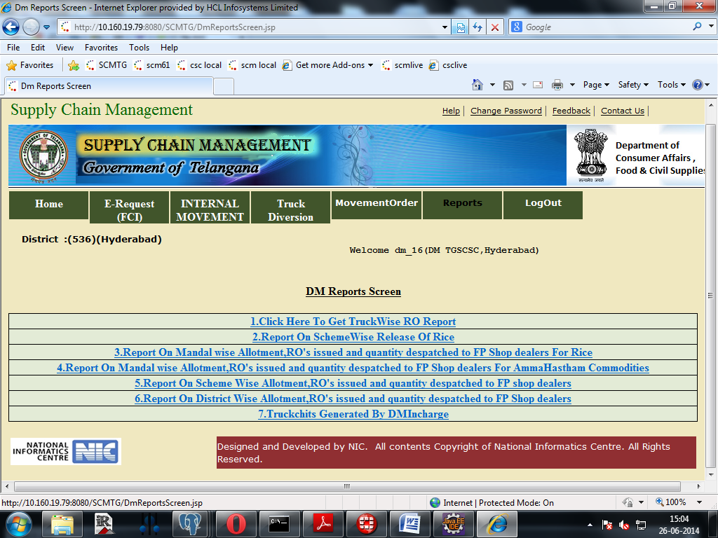
SUPLY CHAIN MANAGEMENT

Slide 22
COMPONENT II - ePOS pilot in Hyderabad - Process Flow
Commodities received at FPS - authenticated by route officer
Any member of the family having aadhar can take
PoS device validates Ration Card number and displays the details of family Members.
PoS Device sends the encrypted XML to Authentication User Agency (AUA) & Forwards the XML to Authentication Service Agency (ASA –dept. engaged BSNL) by adding security keys.
ASA invokes Central Identity Data Repository (CIDR) of UIDAI and transmits the authentication packets to CIDR.
The PoS Device receives the authentication result. If 'YES', the FPS dealer keys in details of commodities and issues ration –
Receipt provided in Telugu.
If 'No', system also handles exceptions ( through VRO/ VRA Authentication)
Beneficiaries have to undergo BFD in order to increase the authentication accuracy (BFD printout is given listing the fingers with a rank & Results stored in PoS)

Slide 23
COMPONENT II - ePOS pilot in Hyderabad - benefits
45 shops - October 2012
Benefits - card holder
Ration assured
Paper slips – transparency
Benefits - dept
Monitor whether the shop opened or not
System generated CBs
Savings
10 % - above seeding savings
Approx Rs 54,000/- per shop per month
6,48,000 per year per shop
Saved on
other welfare schemes
Seasonal migration
Proposing portability after scaling
CBs – through system

Slide 24
ePOS - Lessons Learnt …
Check the connectivity of available SIMS & choose the best. DOCOMO, airtel, BSNL, PSTN of BSNL
Seeding with correct aadhaar. Mismatches – wrong UID
Series of talks with dealers, political representatives, crowd management at FP shops helped. ASo had to give a demo to local MLA
UID seeding at shop for unseeded only. For editing better do at office.

Slide 25
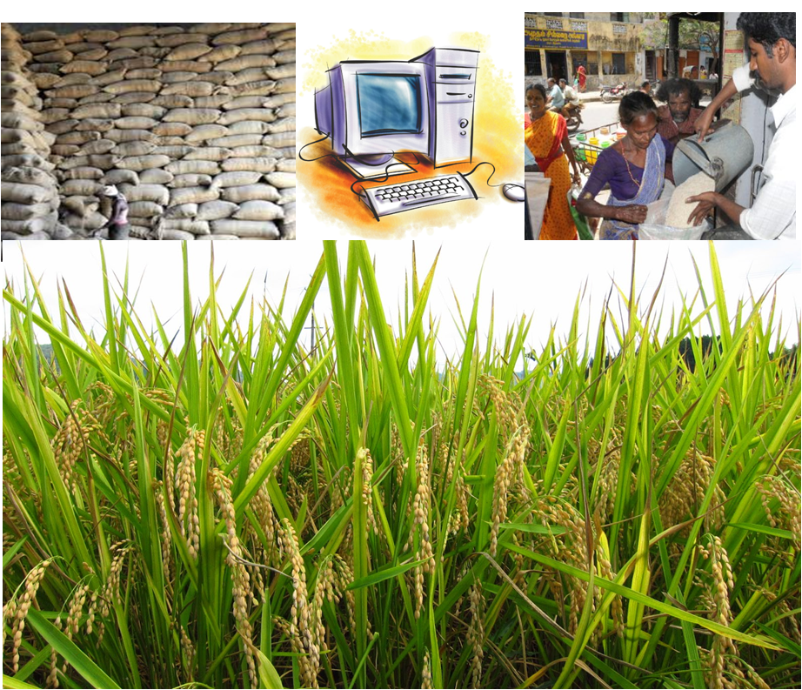
Thank You

